Slide 1
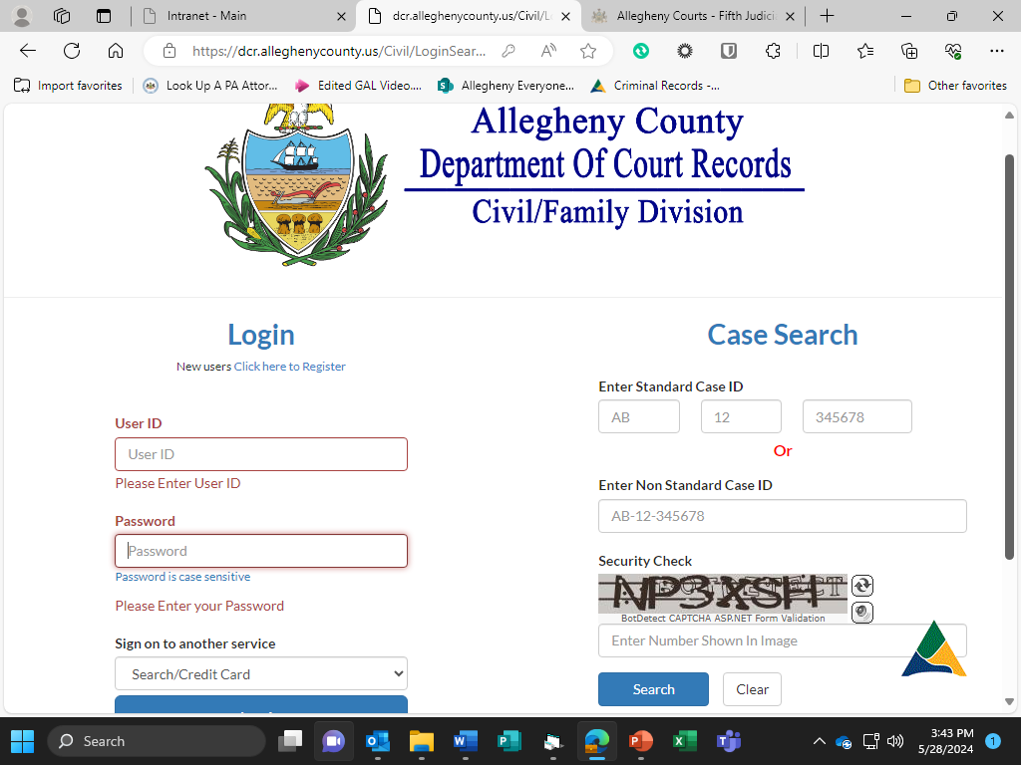
Searching for Your Case at the Department of Court Records Website
Visit: dcr.alleghenycounty.us/Civil/LoginSearch.aspx
Have your Case Number Ready
If you do not know your case number email custodydepartment@alleghenycourts.us or call the Department of Court Records at 412-350-5729
Case Number Example:
  FD 12-03456

Slide 2
Searching for Your Case
- Enter Case Number in the below
like the example.
- Security Check must also be entered. Repeat what you see in security check underneath.
FD 12 03456

Slide 3
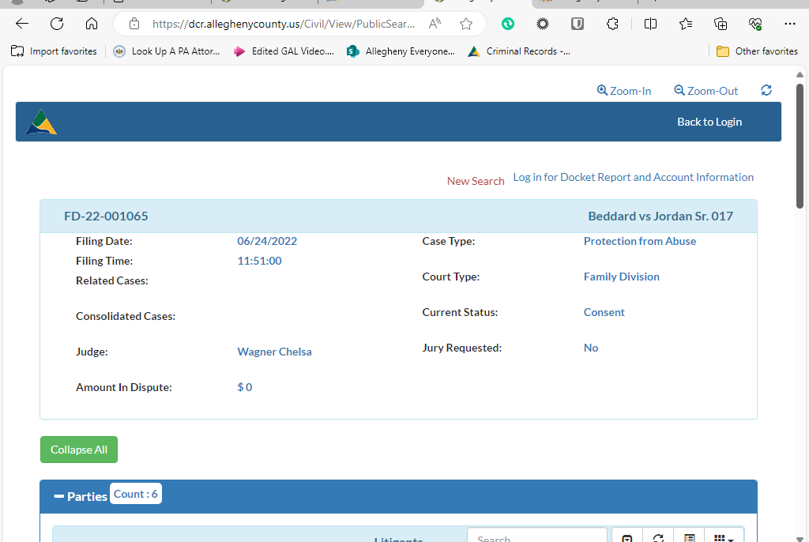
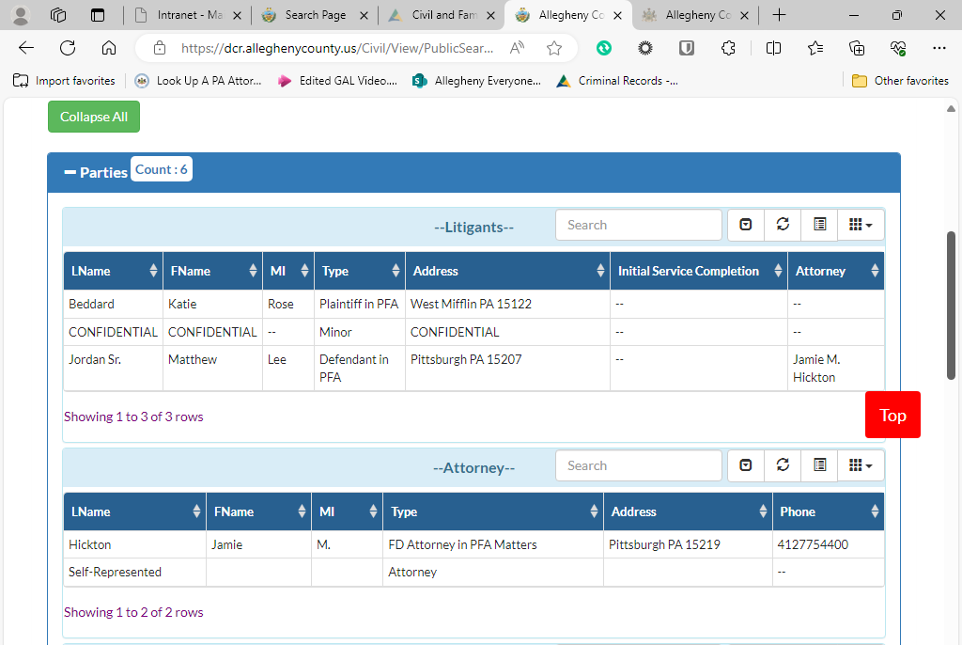
Case Screen View
Case Name will be listed: Example: Doe v. Doe

Slide 4
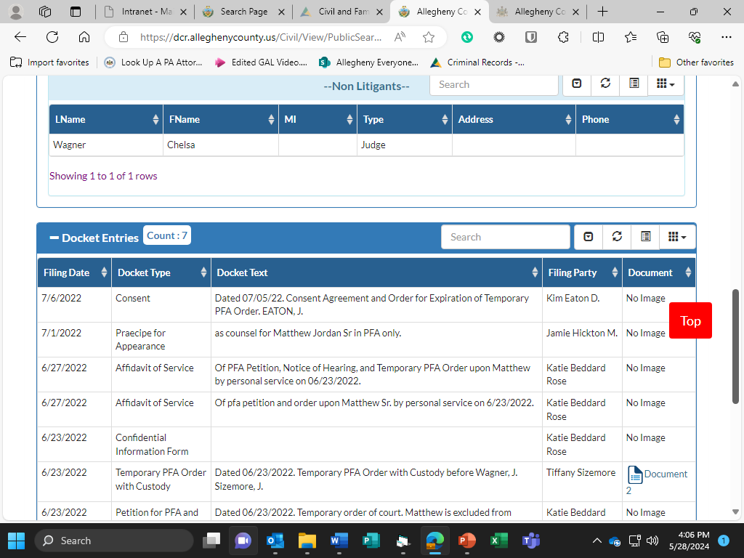
Case Screen View
Please Note: Your View and Access to Documents may be limited due to the Public Access Policy Procedures and Safety Measures.

